Slide 1
ON STATISTICAL LEARNING OF SIMPLICES UNMIXING PROBLEM REVISITED
Gwangwoo Kim
Steptember 26, 2021

Slide 2
Contents
Introduction
Preliminaries
Method and results
Experimental results
References

Slide 3
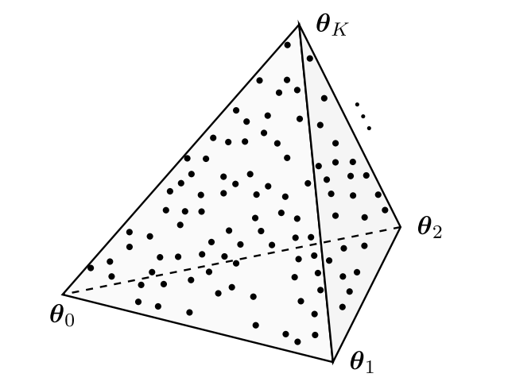
1. Introduction

Slide 4

1. Introduction
This problem can be formulated by
But it is not yet a statistical problem.

Slide 5
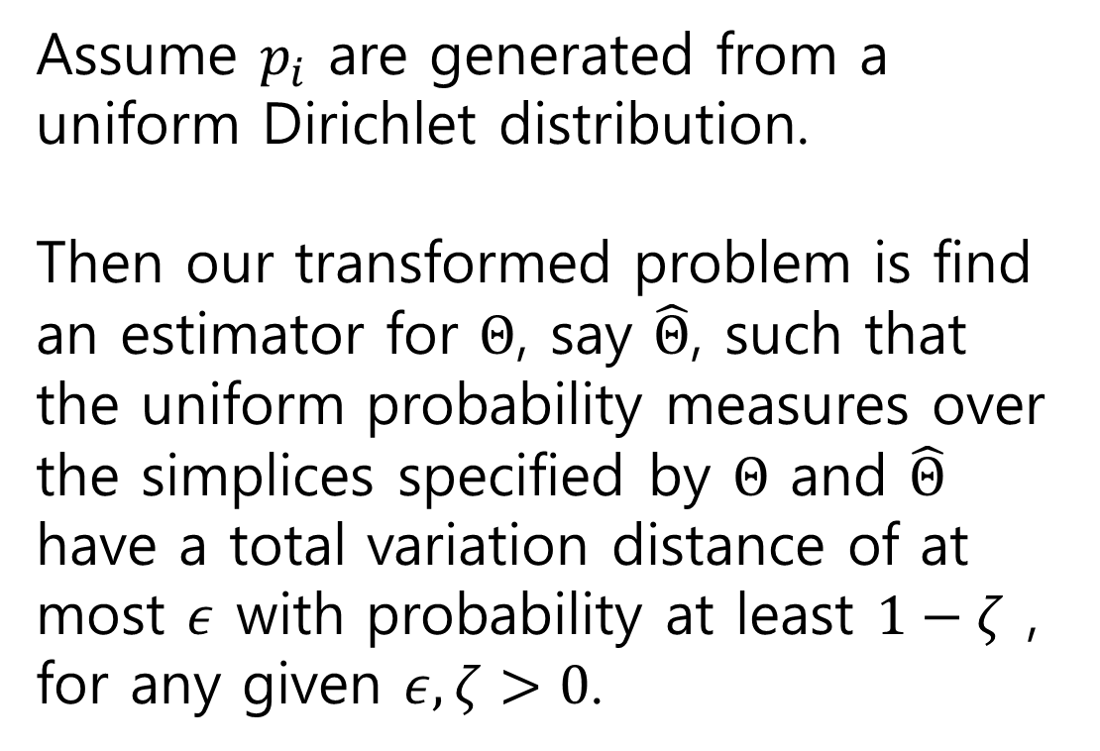
1. Introduction
Assume $p_{i}$ are generated from a uniform Dirichlet distribution.
Then our transformed problem is find an estimator for $Θ$, say $\hat{Θ}$, such that the uniform probability measures over the simplices specified by $Θ$ and $\hat{Θ}$ have a total variation distance of at most $ε$ with probability at least $1−ζ$ , for any given $ε, ζ>0$.

Slide 6
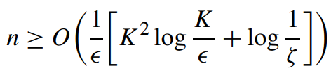

1. Introduction
Existing bound (2012)
Proposed (2021)
Independent Component Analysis (ICA)
heuristic Gradient Descent

Slide 7
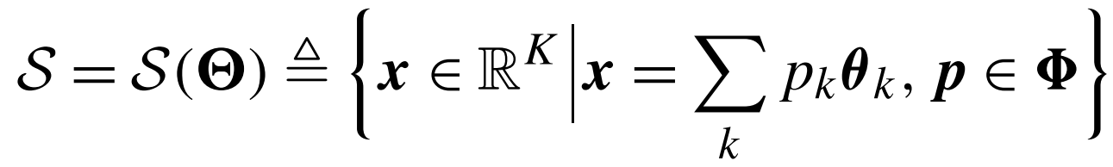

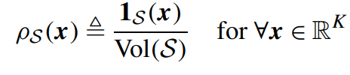
2. Preliminaries

Slide 8
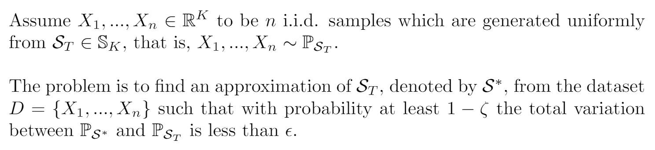
2. Preliminaries

Slide 9
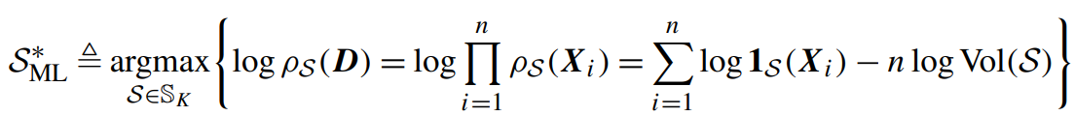
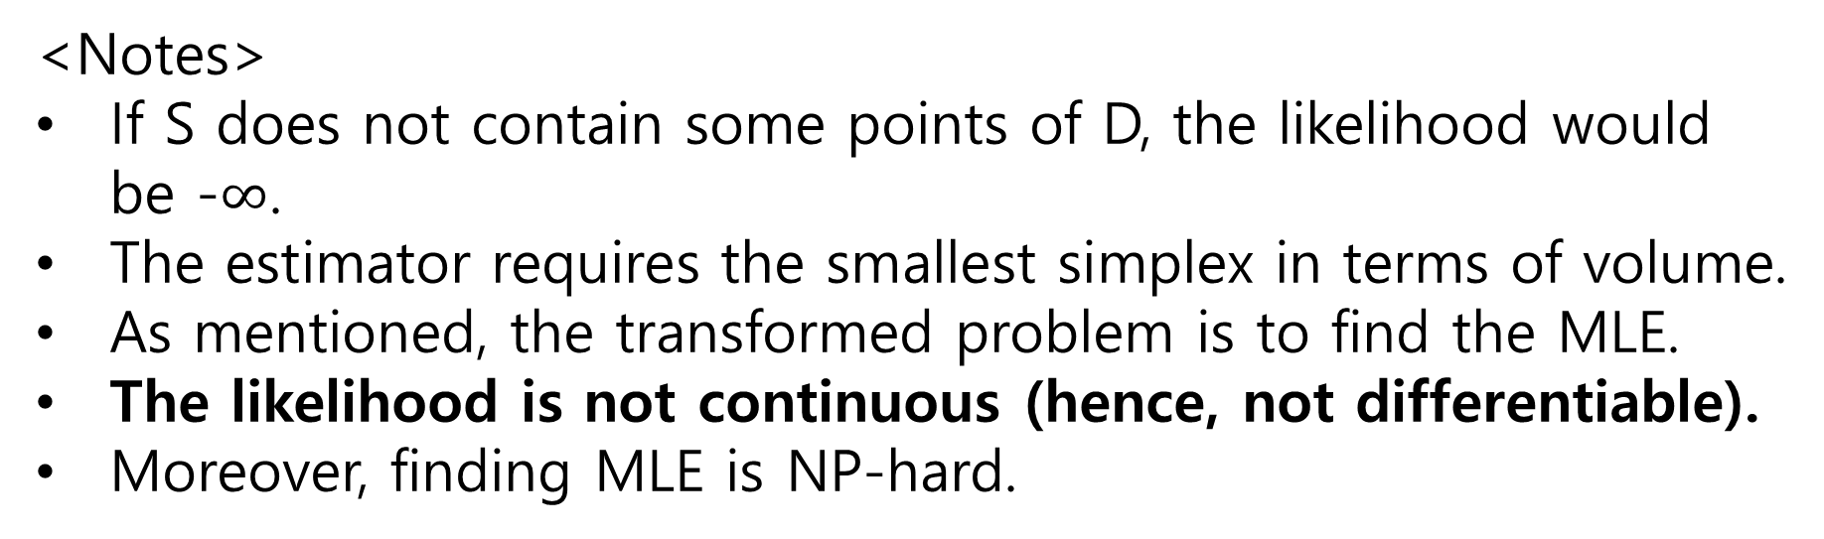
3. Method and results
<Notes>
If S does not contain some points of D, the likelihood would be -$∞$.
The estimator requires the smallest simplex in terms of volume.
As mentioned, the transformed problem is to find the MLE.
The likelihood is not continuous (hence, not differentiable).
Moreover, finding MLE is NP-hard.

Slide 10
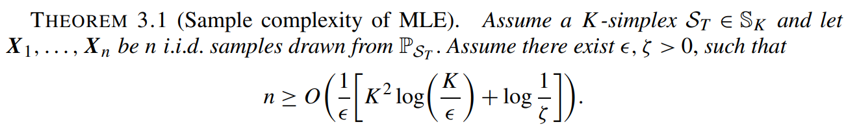
3. Method and results
<Remark> Interestingly, the given guarantees on the accuracy of MLE hold regardless of the shape of the simplex and does not impose any geometric constraints on the true simplex.

Slide 11
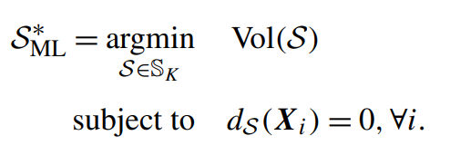
3. Method and results
By the computational hardness of MLE, we should replace the objective function with a continuously relaxed surrogate. Let’s reformulate our problem.

Slide 12
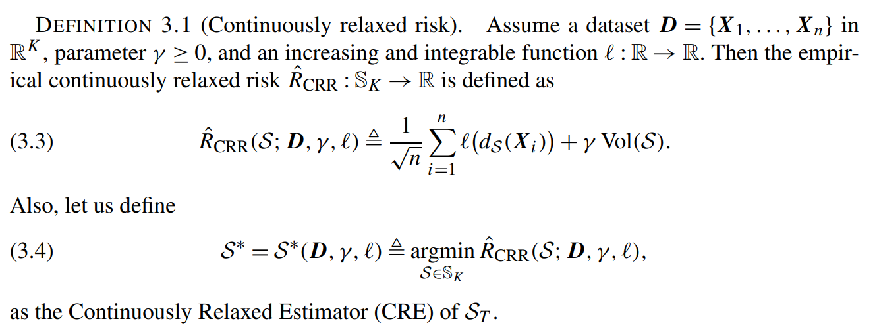
3. Method and results
<cf>

Slide 13
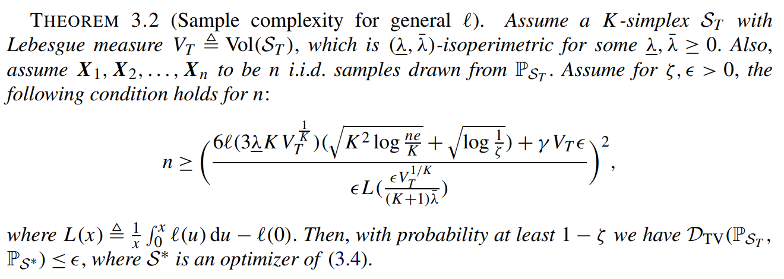
3. Method and results
The proof follows from Vapnik–Chervonenkis (VC) theory of statistical learning.

Slide 14
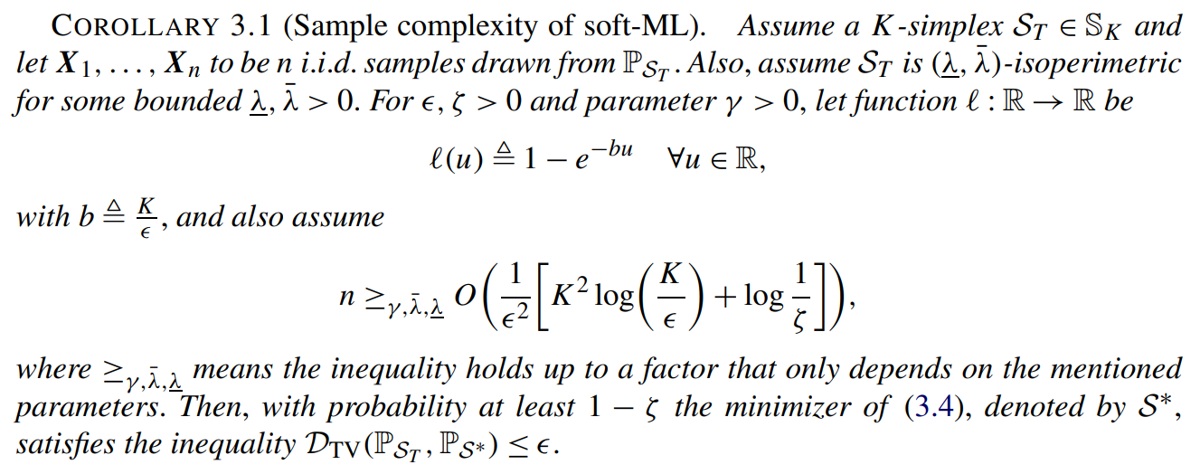
3. Method and results
<cf>

Slide 15
3. Method and results
<cf>

Slide 16
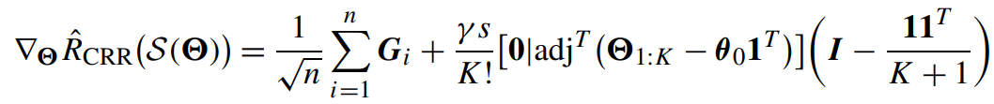

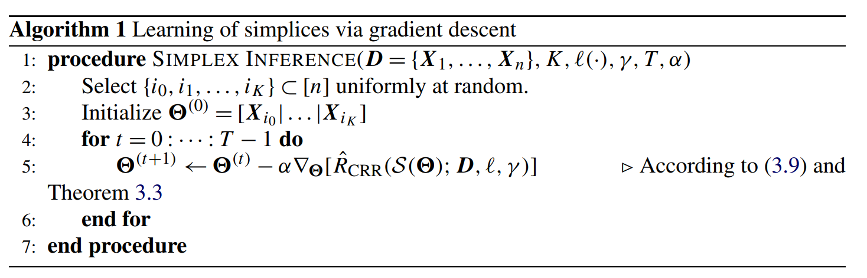
3. Method and results
where

Slide 17
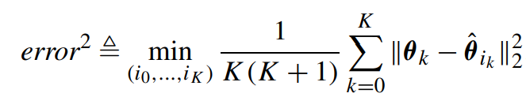
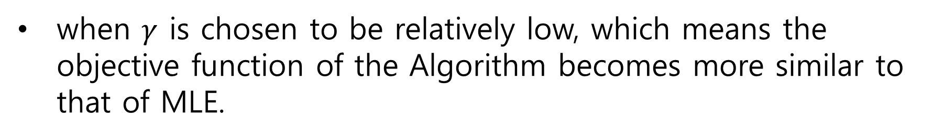
4. Experimental results
We define error of two simplices by
The initialization of the algorithm is not important, but such a convex hull lead to a substantially faster convergence.
when $γ$ is chosen to be relatively low, which means the objective function of the Algorithm becomes more similar to that of MLE.

Slide 18
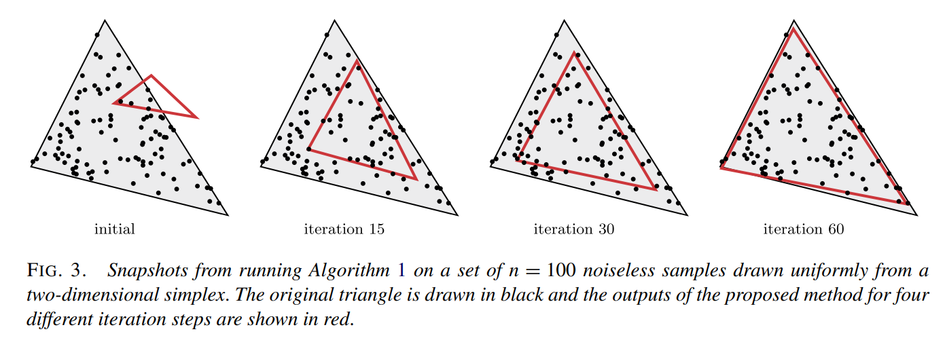
4. Experimental results

Slide 19
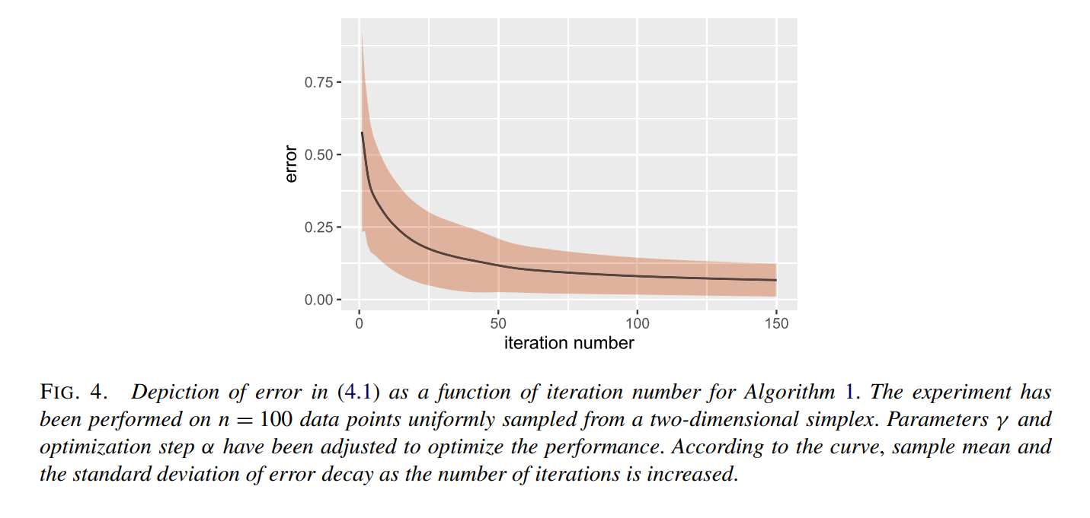
4. Experimental results

Slide 20
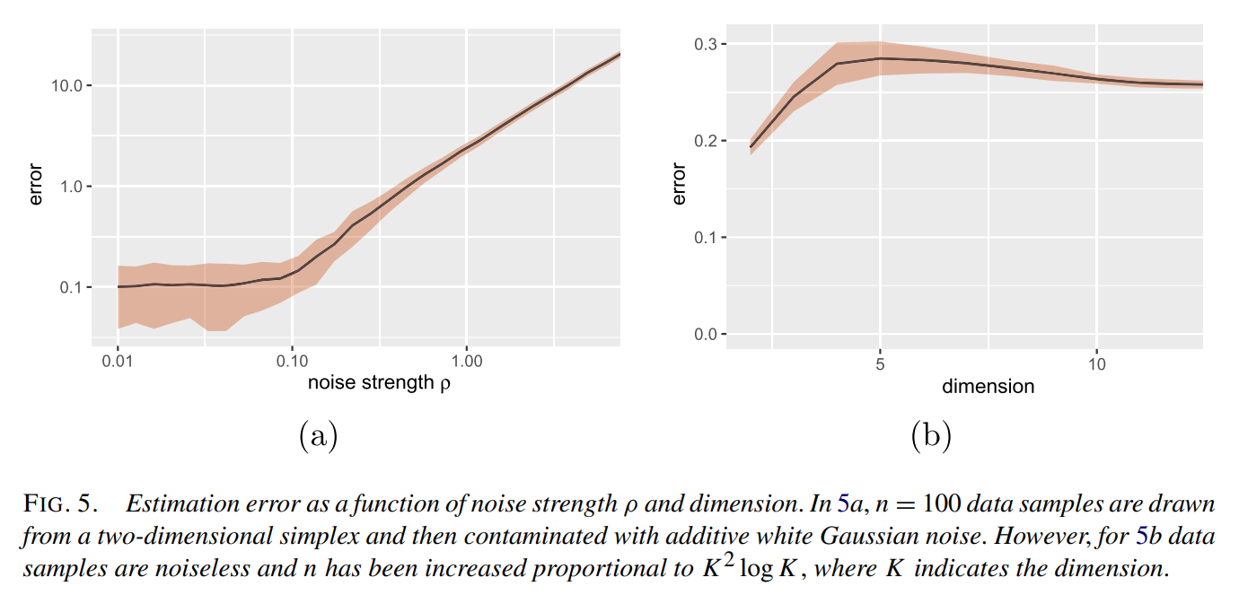
4. Experimental results

Slide 21
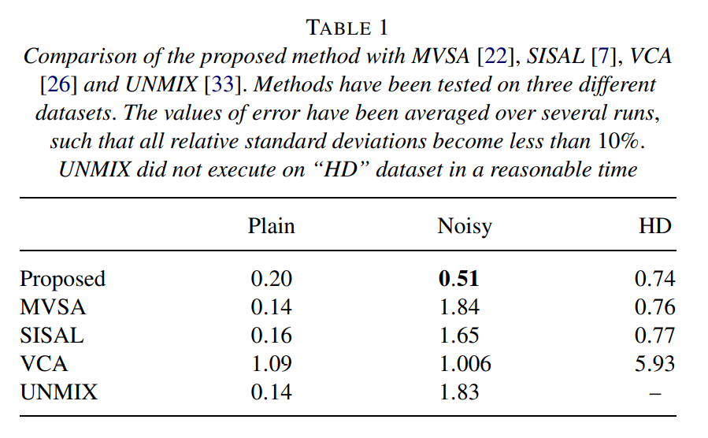
4. Experimental results

Slide 22
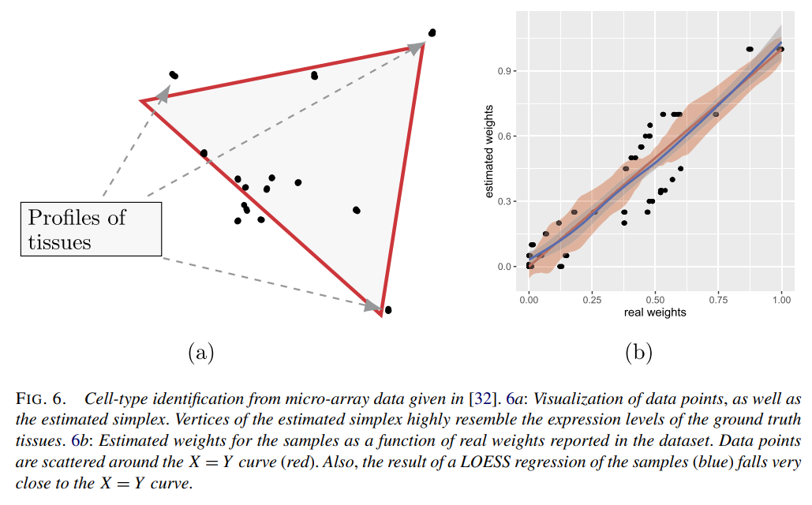
4. Experimental results

Slide 23
5. References
Anderson, J., Goyal, N., & Rademacher, L. (2013, June). Efficient learning of simplices. In Conference on Learning Theory (pp. 1020-1045). PMLR.
Najafi, A., Ilchi, S., Saberi, A. H., Motahari, S. A., Khalaj, B. H., & Rabiee, H. R. (2021). On statistical learning of simplices: Unmixing problem revisited. The Annals of Statistics, 49(3), 1626-1655.

